Slide 1
UNIT 3: Control Flow

Slide 2
IF-ElSE
What is Decision Making Statement?
In the C programming language, the program execution flow is line by line from top to bottom.
That means the c program is executed line by line from the main method.
But this type of execution flow may not be suitable for all the program solutions. Sometimes, we make some decisions or we may skip the execution of one or more lines of code.
Consider a situation, where we write a program to check whether a student has passed or failed in a particular subject.
Here, we need to check whether the marks are greater than the pass marks or not. If marks are greater, then we decide that the student has passed otherwise failed.
To solve such kind of problems in c we use the statements called decision making statements.

Slide 3
Continue
Decision-making statements are the statements that are used to verify a given condition and decide whether a block of statements gets executed or not based on the condition result.
In the c programming language, there are two decision-making statements they are as follows.
if statement
switch statement

Slide 4
if statement in c
if statement in c
In c, if statement is used to make decisions based on a condition.
The if statement verifies the given condition and decides whether a block of statements are executed or not based on the condition result.
In c, if statement is classified into four types as follows...
Simple if statement
if-else statement
Nested if statement
if-else-if statement (if-else ladder)

Slide 5
Simple if statement
Simple if statement is used to verify the given condition and executes the block of statements based on the condition result.
The simple if statement evaluates specified condition. If it is TRUE, it executes the next statement or block of statements.
If the condition is FALSE, it skips the execution of the next statement or block of statements.
The general syntax and execution flow of the simple if statement is as follows.

Slide 6
if (condition) Relational or logical operator
{
Statements;
Statements;
}
Description:
In these type of statements, if condition is true, then respective block of code is executed.

Slide 7
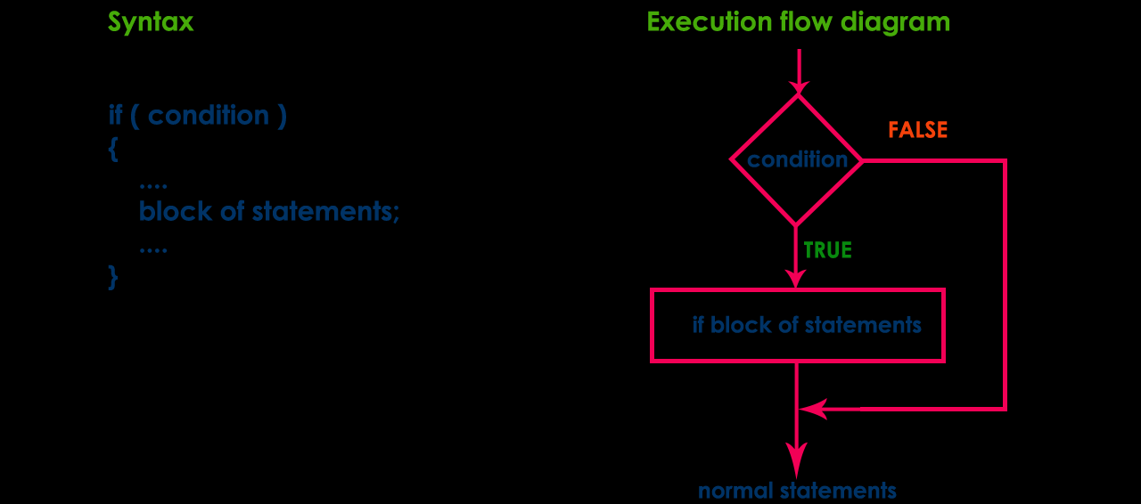

Slide 8
Write a program to input user age and check if he is eligible to vote in India or not. A person in India is eligible to vote if he is 18+
Algo
Step 1: Start.
Step 2: Read age from the user.
Step 3: If age is greater than 18 then go to step 4
Step 4: Print a he is eligible for vote
Step 5: Stop

Slide 9
False
True
Start
Read age
If age>=18
Display eligible for vote
Stop

Slide 10
Program
#include <stdio.h>
#include<conio.h>
main()
{
int age;
printf("Enter your age: ");
scanf("%d", &age);
if(age >= 18)
{
printf("You are eligible to vote in India.");
}
getch();
}

Slide 11
ALGO
Program for evaluating the whether given no is greater than 0
Step 1: Start.
Step 2: Take one inputs (a ) from the user.
Step 3: If a is greater than 0 then go to step 4
Step 4: Print a greater than 0
Step 5: Stop

Slide 12
False
True
Start
Read a
If a>=0
A is greater
Stop

Slide 13
Program for evaluating the whether given no is greater than 0
#include<stdio.h>
#include<conio.h>
void main()
{
int i=20;
//clrscr();
if(i>=0)
printf("Yes the given no is greater then 0");
getch();
}

Slide 14
if-else statement
The if-else statement is used to verify the given condition and executes only one out of the two blocks of statements based on the condition result.
The if-else statement evaluates the specified condition.
If it is TRUE, it executes a block of statements (True block).
If the condition is FALSE, it executes another block of statements (False block). The general syntax and execution flow of the if-else statement is as follows.

Slide 15
SYNTAX of If-else
if(condition)
{
//Statement block
}
else
{
//Statement block
}

Slide 16
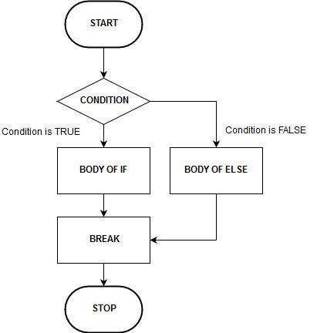

Slide 17
If ( a%2==0 )
4/2=2
4%2=0

Slide 18
even or odd
Logic to check even or odd
A number exactly divisible by 2 leaving no remainder, is known as even number. Programmatically, if any number modulo divided by 2 equals to 0 then, the number is even otherwise odd.
Step by step descriptive logic to check whether a number is even or odd.
Input a number from user. Store it in some variable say num.
Check if number modulo division equal to 0 or not i.e. if(num % 2 == 0) then the number is even otherwise odd.

Slide 19
Program for Odd n even
Algorithm for odd n even no
Step 1: Start.
Step 2: Take input from the user.
Step 3: Check condition. If remainder is zero go to step 4 else go to step 5
Step 4: Print a is even and go to step 6
Step 5: Print a is oddand go to step 6
Step 6: Stop

Slide 20
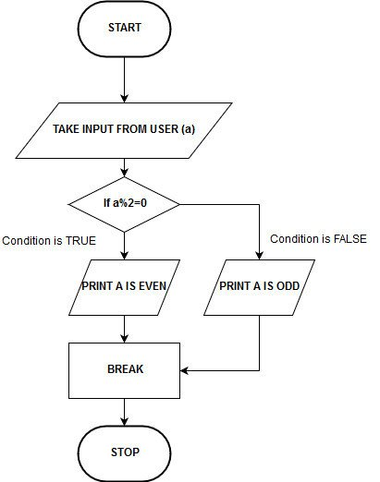

Slide 21
Write a program to input two numbers from user. Print maximum between both the given numbers.
Step 1 → START
Step 2 → Read two integer variable num1 & num2
Step 3 → check num1>num2 then go to step 4
Step 4 → print num 1 is maximum
Step 5 → else num2 is maximum
Step 6 → STOP

Slide 22
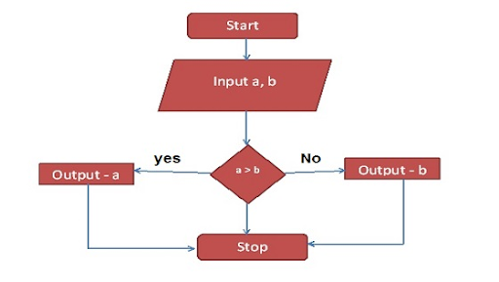

Slide 24
if-else-if ladder
The if-else-if ladder statement is an extension to the if-else statement.
It is used in the scenario where there are multiple cases to be performed for different conditions.
In if-else-if ladder statement, if a condition is true then the statements defined in the if block will be executed, otherwise if some other condition is true then the statements defined in the else-if block will be executed, at the last if none of the condition is true then the statements defined in the else block will be executed.
There are multiple else-if blocks possible.
It is similar to the switch case statement where the default is executed instead of else block if none of the cases is matched.

Slide 25
Syntax
if(condition1)
{
//code to be executed if condition1 is true
}
else if(condition2)
{
//code to be executed if condition2 is true
}
else if(condition3)
{
//code to be executed if condition3 is true
}
...
else
{
//code to be executed if all the conditions are false
}

Slide 26
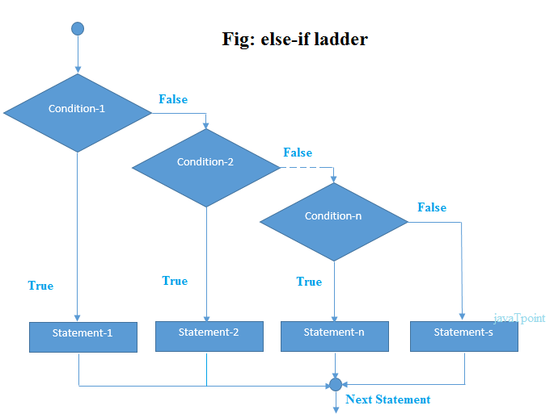

Slide 27
Program to check alphabet, digit or special character
Logic to check alphabet, digit or special character
A character is alphabet if it in between a-z or A-Z.
A character is digit if it is in between 0-9.
A character is special symbol character if it neither alphabet nor digit.
Step by step descriptive logic to check alphabet, digit or special character.
Input a character from user. Store it in some variable say ch.
First check if character is alphabet or not. A character is alphabet if((ch >= 'a' && ch <= 'z') || (ch >= 'A' && ch <= 'Z')).
Next, check condition for digits. A character is digit if(ch >= '0' && ch <= '9').
Finally, if a character is neither alphabet nor digit, then character is a special character.
Let us implement the above logic in a C program.

Slide 28
Program to check alphabet, digit or special character
Step 1 → START
Step 2 → Take character variable ch
Step 3 → If a enter character ch is in between an alphabet a-z or A-Z then go to step 4
Step 4 → Print it is alphabet
Step 5 → If a enter character ch is in between digit 0-9 then go to step 6
Step 6 → Print it is an digit.
Step 7 → If a enter character ch is neither a alphabet nor digit so it is a special symbol then go to step 8
Step 8 → Print it is special character.
Step 9 → STOP

Slide 29
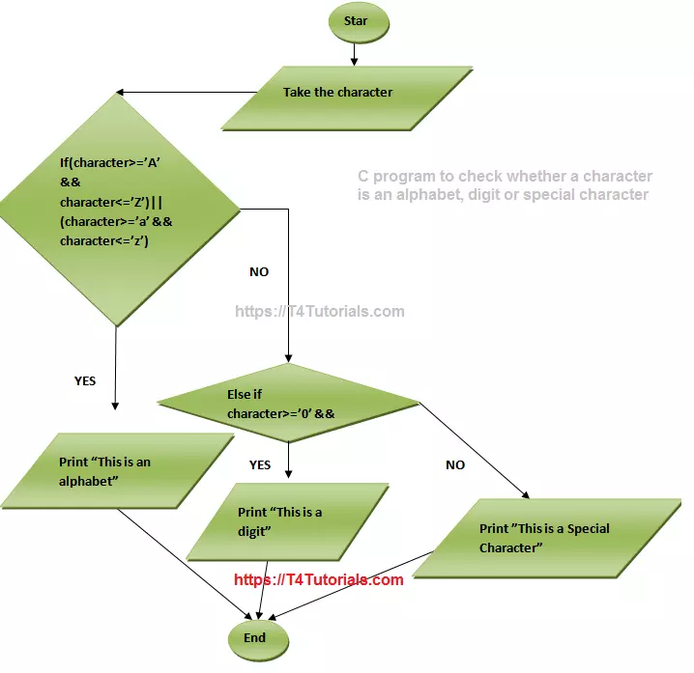

Slide 30
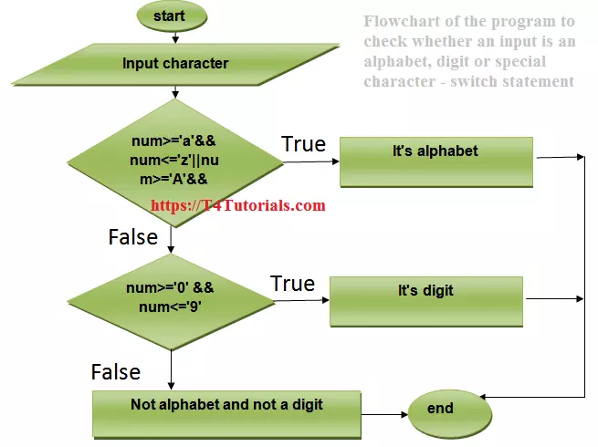

Slide 31
#include <stdio.h>
#include <conio.h>
{
char ch;
printf("Enter any character: ");
scanf("%c", &ch);
if((ch >= 'a' && ch <= 'z') || (ch >= 'A' && ch <= 'Z'))
{
printf("'%c' is alphabet.", ch);
}
else if(ch >= '0' && ch <= '9')
{
printf("'%c' is digit.", ch);
}
else
{
printf("'%c' is special character.", ch);
}
getch();
}

Slide 32
C program to enter student marks and find percentage and grade
If mark>= 80% : Grade A If mark >= 60% : Grade B If mark >= 40% : Grade C

Slide 33
Program to find out grade according to marks given of students.
Step 1 → START
Step 2 →Enter students name
Step 3 →Enter students marks
Step 4 → If a enter marks is greater than or equal to 80 then goto step 5
Step 5 → Display grade A
Step 6 → If a enter marks is greater than or equal to 60 then goto step 7
Step 7 → Display grade B
Step 8 → If a enter marks is greater than or equal to 40 then goto step 9
Step 9 → Display grade C
Step 10 → Else students is Fail.
Step 11 → STOP

Slide 34
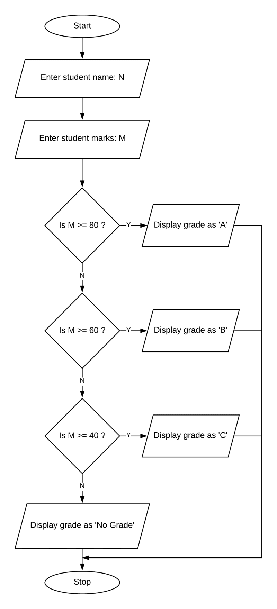

Slide 35
#include <stdio.h>
int main()
{
int phy, chem, bio, math, comp;
float per;
/* Input marks of five subjects from user */
printf("Enter five subjects marks: ");
scanf("%d%d%d%d%d", &phy, &chem, &bio, &math, &comp);
/* Calculate percentage */
per = (phy + chem + bio + math + comp) / 5.0;
printf("Percentage = %.2f\n", per);
/* Find grade according to the percentage */
if(per >= 80)
{
printf("Grade A");
}
else if(per >= 60)
{
printf("Grade B");
}

Slide 36
else if(per >= 40)
{
printf("Grade C");
}
else
{
printf("FAIL");
}
return 0;
}

Slide 37
Write a c program to print grade of a students according to their marks

Slide 38
Check if the given integer is negative, zero or positive?

Slide 39
#include <stdio.h>
int main()
{
/* Declare integer variable */
int num;
/* Input an integer from user */
printf("Enter any number: ");
scanf("%d", &num);
if(num < 0)
{
/* If number is less than zero, then it is negative */
printf("NUMBER IS NEGATIVE.");
}
else if(num == 0)
{
/* If number equal to 0, then it is zero */
printf("NUMBER IS ZERO.");
}
else
{
/* If number is greater then zero, then it is positive */
printf("NUMBER IS POSITIVE.");
}
return 0;
}

Slide 40
#include<stdio.h>
int main(){
int number=0;
printf("enter a number:");
scanf("%d",&number);
if(number==10)
{
printf("number is equals to 10");
}
else if(number==50){
printf("number is equal to 50");
}
else if(number==100){
printf("number is equal to 100");
}
else{
printf("number is not equal to 10, 50 or 100");
}
return 0;
}

Slide 41
Nested IF
When an if else statement is present inside the body of another “if” or “else” then this is called nested if else.
A nested if in C is an if statement that is the target of another if statement.
Nested if statements means an if statement inside another if statement.
C allows us to nested if statements within if statements, i.e, we can place an if statement inside another if statement.

Slide 42
Syntax:
if (condition1)
{
// Executes when condition1 is true
if (condition2)
{
// Executes when condition2 is true
}
else (condition2)
{
// Executes when condition2 is true
}
}
else
{
// Executes when condition2 is true
}

Slide 43
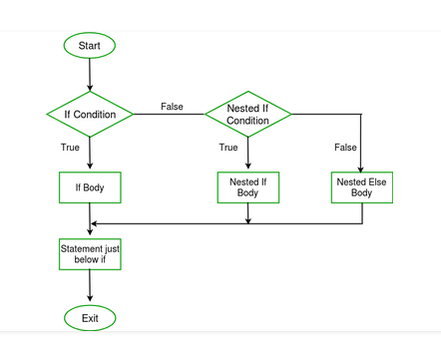

Slide 44
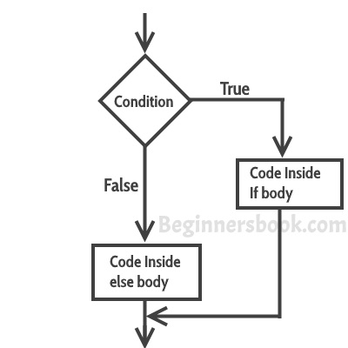

Slide 45
Find largest among 3 variables using nested if */ #include <stdio.h> int main() { int a,b,c; printf("Enter 3 numbers: \n"); scanf("%d %d %d",&a,&b,&c); if(a>=b) { if(a>=c) printf("%d is largest",a); else printf("%d is largest",c); }
else
{
if(b>=c) printf("%d is largest",b); else printf("%d is largest",c); } }

Slide 46
Switch statement
Consider a situation in which we have many options out of which we need to select only one option that is to be executed.
Such kind of problems can be solved using nested if statement.
But as the number of options increases, the complexity of the program also gets increased.
This type of problem can be solved very easily using a switch statement.
Using the switch statement, one can select only one option from more number of options very easily.
In the switch statement, we provide a value that is to be compared with a value associated with each option.
Whenever the given value matches the value associated with an option, the execution starts from that option. In the switch statement, every option is defined as a case.

Slide 47
Continue
The switch statement contains one or more cases and each case has a value associated with it.
At first switch statement compares the first case value with the switchValue, if it gets matched the execution starts from the first case.
If it doesn't match the switch statement compares the second case value with the switch Value and if it is matched the execution starts from the second case.
This process continues until it finds a match.
If no case value matches with the switchValue specified in the switch statement, then a special case called default is executed

Slide 48
Continue
When a case value matches with the switch Value, the execution starts from that particular case.
This execution flow continues with the next case statements also.
To avoid this, we use the "break" statement at the end of each case.
That means the break statement is used to terminate the switch statement.
However, it is optional.

Slide 49
Syntax
switch (expression/value/condition) { case label1 :statements; label (int /char constant) break;
case label2: statements; break; case label3: statements; break; default: statements; break; }

Slide 50
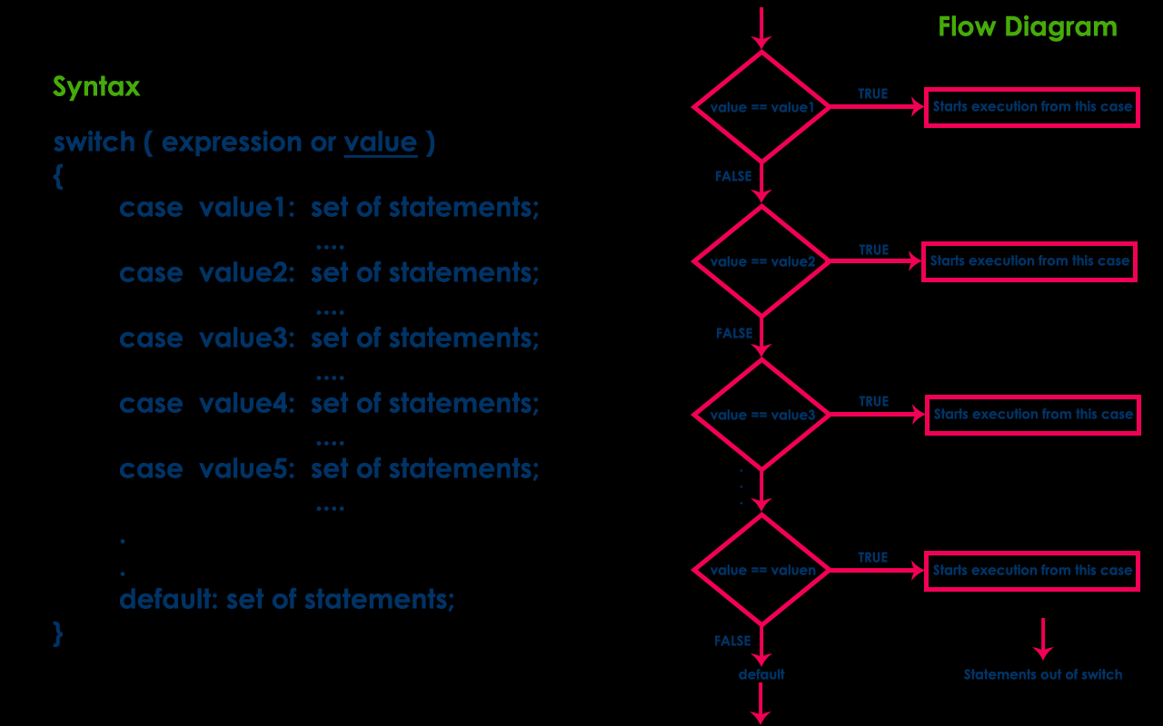

Slide 51
C program to check vowel or consonant using switch case
Logic to check vowel or consonant using switch...case statement
English alphabets 'a', 'e', 'i', 'o', 'u' both lowercase and uppercase are known as vowels.
Alphabets other than vowels are known as consonants.

Slide 52
Algorithm
Step by step descriptive logic to check vowel or consonant.
Input an alphabet from user. Store it in some variable say ch.
Switch the value of ch.
For ch, there are 10 possibilities for vowel we need to check i.e. a, e, i, o, u, A, E, I, O and U.
Write all 10 possible cases for vowels and print "Vowel" for each case.

Slide 53
Algorithm to check vowel or consonant using switch case
Step 1 → START
Step 2 →Read input an alphabet from user ch
Step 3 → Switch the value of ch.
Step 4 → Write all 10 possible cases for vowels ,if true then go to step 5
Step 5 → Display "Vowel" for each case.
Step 6 → If alphabet is not vowel then add a default case & go to step 7
Step 7 → Display "Consonant".
Step 8 → STOP

Slide 54
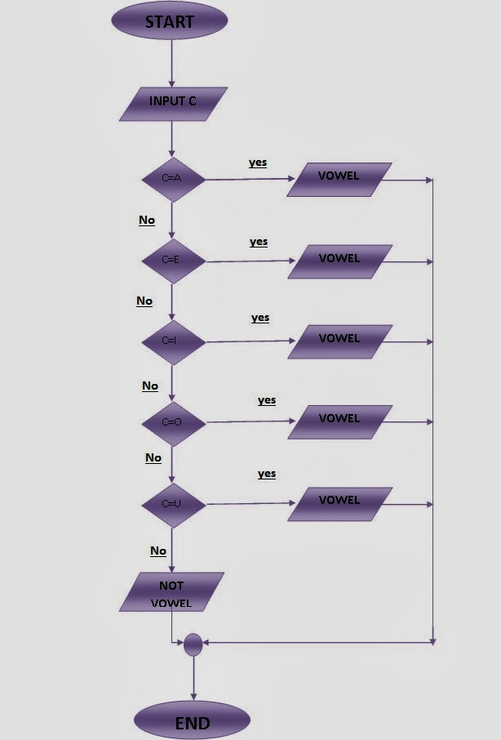

Slide 55
#include <stdio.h>
main()
{
char ch;
printf("Enter any alphabet: ");
scanf("%c", &ch);
switch(ch)
{
case 'a':
printf("Vowel");
break;
case 'e':
printf("Vowel");
break;
case 'i':
printf("Vowel");
break;
case 'o':
printf("Vowel");
break;
case 'u':
printf("Vowel");
break;

Slide 56
case 'A':
printf("Vowel");
break;
case 'E':
printf("Vowel");
break;
case 'I':
printf("Vowel");
break;
case 'O':
printf("Vowel");
break;
case 'U':
printf("Vowel");
break;
default:
printf("Consonant");
}
}

Slide 57
Program to calculate the area of a rectangle or circle or triangle by taking the user’s choice.
Step 1: Start
Step 2: Initialize variables
Step 3: Take input for choice and then for area variables from the user
Step 4: Case 1: Circle: 3.14*3.14*r
Case 2: Rectangle: ar=a*b
Case 3: Triangle: at=0.5*a*b
Step 5: Display output according to case
Step 6: Stop

Slide 58
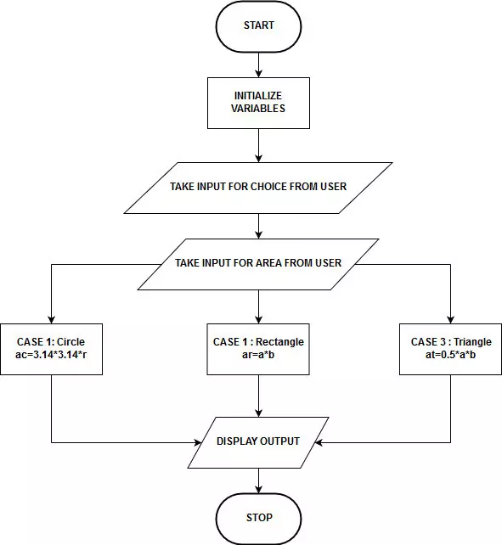
Flowchart

Slide 59
Program to calculate the area of a rectangle or circle or triangle by taking the user’s choice.
#include<stdio.h>
#include<conio.h>
void main()
{
int ac,ar,at,r,a,b;
char choice;
printf("Enter your choice\n”);
prinft(“A for area of circle\n”);
printf(“B for area of rectangle\n”);
printf(“C for area of triangle\n");
scanf("%c",&choice);
switch(choice)
{
case ‘A’:
printf("Enter radius: ");
scanf("%d",&r);
ac=3.14*3.14*r;
printf("Area of circle is: %d",ac);
break;
9

Slide 60
case ‘B’:
printf("Enter length and breadth:");
scanf("%d %d",&a,&b);
ar=a*b;
printf("Area of rectangle is: %d",ar);
break;
case ‘C’:
printf("Enter base and height: ");
scanf("%d %d",&a,&b);
at=0.5*a*b;
printf("Area of triangle is: %d",at);
break;
}
getch();
}

Slide 61
C program to design calculator with basic operations using switch
Step 1 → START
Step 2 →Read input two numbers and a character from user ,store them in some variable say num1, op and num2.
Step 3 → Switch the value of op i.e. switch(op).
Step 4 → Write all four possible values of op i.e. '+', '-', '*' and '/'.
Step 5 → For case '+' perform addition and store result in some variable i.e. result = num1 + num2.
Step 6 → for case '-' perform subtraction and store result in some variable i.e. result = num1 - num2.
Step 7 → for case ‘*' perform subtraction and store result in some variable i.e. result = num1 *num2.
Step 8 → for case ‘/' perform subtraction and store result in some variable i.e. result = num1 - num2.
Step 9 →Finally print the value of result.
Step 10 →STOP

Slide 62
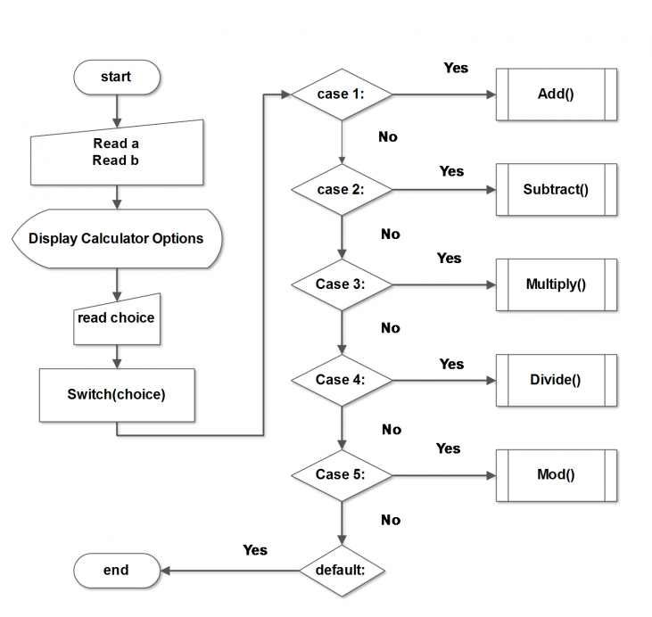

Slide 63
#include <stdio.h>
int main()
{
int num1,num2;
float result;
char ch; //to store operator choice
printf("Enter first number: ");
scanf("%d",&num1);
printf("Enter second number: ");
scanf("%d",&num2);
printf("Choose operation to perform (+,-,*,/,%): ");
scanf(" %c",&ch);
result=0;
switch(ch)
{
case '+':
result=num1+num2;
break;
case '-':
result=num1-num2;
break;

Slide 64
case '*':
result=num1*num2;
break;
case '/':
result=num1/num2;
break;
default:
printf("Invalid operation.\n");
}
printf("Result: %d %c %d = %f\n",num1,ch,num2,result);
}

Slide 65
C program to create calculator using switch case and functions
#include <stdio.h>
main()
{
int op,a,b,add,sub,divi,mul;
printf("Enter the two no");
scanf("%d%d",&a,&b);
printf("\n Simple Calculator");
printf("\n 1.ADDITION");
printf("\n 2.SUBTRACTION");
printf("\n 3.MULTIPLICATION");
printf("\n 4.DIVISION");
printf("\n\nEnter your OPTION");
scanf("%d",&op);

Slide 66
switch(op)
{
case 1:
add=a+b;
printf("\nThe Addition of two no is=%d",add);
break;
case 2:
sub=a-b;
printf("\nThe Subtraction of two no is=%d",sub);
break;
case 3:
mul=a*b;
printf("\nThe Multiplication of two no is=%d",mul);
break;
case 4:
divi=a/b;
printf("\nThe Divisiontion of two no is=%d",divi);
break;
}
}

Slide 67
C Loops
What are Loops In C Programming?
To perform a particular task or to run a specific block of code several times, the concept of LOOP comes in picture.
A loop is an instruction given to the computer that it has to run a specific part of the code for a given number of times.

Slide 68
C Loops
The looping can be defined as repeating the same process multiple times until a specific condition satisfies.
Why use loops in C language?
Consider a situation in which we execute a single statement or block of statements repeatedly for the required number of times.
Such kind of problems can be solved using looping statements in C.
For example, assume a situation where we print a message 100 times.
If we want to perform that task without using looping statements, we have to either write 100 printf statements or we have to write the same message 100 times in a single printf statement.
Both are complex methods.
The same task can be performed very easily using looping statements.

Slide 69
Advantage of loops in C
Advantage of loops in C
1) It provides code reusability.
2) Using loops, we do not need to write the same code again and again.
3) Using loops, we can traverse over the elements of data structures (array or linked lists).
Types of C Loops
There are three types of loops in C language that is given below:
do while
while
for

Slide 70
while loop in C
The while loop begins by first checking the terminal condition and then decides whether to enter the loop or not.
If the underlying condition is true, then it goes ahead and executes the block of code in the loop.
After the first iteration, it again checks with the changed (increased/decreased) values of the variables (the condition operands) and decides the further course of execution.
The while statement is also known as Entry control looping statement.

Slide 71
Syntax
while(condition)
{
statements;
............
Increment or Decrements (++ or --);
}

Slide 72
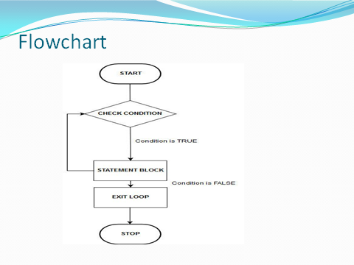
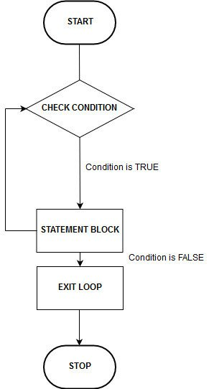
Flowchart

Slide 73
Program to print natural numbers from 1 to 10
LOGIC
Input upper limit to print natural number from user. Store it in some variable say N.
Run a while loop from 1 to N with 1 increment.
Why starting from 1? Because we need to print natural numbers from 1.
Why going till n? Because we need to print natural numbers up to n.
Why increment loop counter by 1? Because difference between two natural numbers is 1.
Therefore if n is one natural number then next natural number is given by n+1.
Inside the loop body print the value of i. You might think, why print value of i inside loop? Because we need to print natural numbers from 1 to N and from loop structure it is clear that i will iterate from 1 to N.
So to print from 1 to N print the value of i.

Slide 74
Algorithm for program to print natural numbers from 1 to n
step 1: Start.
Step 2: Initialize variables.
Step 3: Check while condition.
Step 4: If the condition is true, then go to step 5 otherwise go to step 7.
Step 5: Display the Natural numbers
Step 6: Go to step 3 until the condition is fail.
Step 7: After the condition fail go to step 8..
Step 8: Stop.

Slide 75
Condition true Condition False
START
Accept input from the user
i<=n
Print the natural no
STOP

Slide 76
Program to print natural numbers from 1 to 10
#include <stdio.h>
main()
{
int i=1;
while(i<=10)
{
printf("\nThe Natural number are from 1 to 10 are:%d",i);
i++;
}
return 0;
}

Slide 77
Program to print natural numbers from 1 to n
#include <stdio.h>
main()
{ int i=1,n;
printf("Enter the size of an natural number n"); scanf("%d",&n);
while(i<=n)
{
printf("\nThe Natural number are from 1 to 10 are:%d",i);
i++;
}
}

Slide 78
Program to print table for the 2 using while loop in C
Program to print table for the 2 using while loop in C
#include <stdio.h>
void main()
{
int i=1,table;
while(i<=10)
{
table=i*2;
printf("\nThe table of 2 is: %d",table);
i++;
}
}

Slide 79
Program to print table for the given number using while loop in C
#include <stdio.h>
void main()
{
int i=1,n,table;
printf("Enter the number");
scanf("%d",&n);
while(i<=10)
{
table=i*n;
printf("\nThe table %d",table);
i++;
}
}

Slide 80
Program to print alphabets from a-z
#include<stdio.h>
main()
{
char ch='a';
while(ch<='z')
{
printf("\nThe Albhabetc character from a to z is=%c“ ch);
ch++;
}
}

Slide 81
Do-While Loop
The do-while statement is used to execute a single statement or block of statements repeatedly as long as given the condition is TRUE.
The do-while statement is also known as the Exit control looping statement

Slide 82
Working of Do-While Loop
At first, the single statement or block of statements which are defined in do block are executed.
After the execution of the do block, the given condition gets evaluated.
If the condition is evaluated to TRUE, the single statement or block of statements of do block are executed again.
Once the execution gets completed again the condition is evaluated.
If it is TRUE, again the same statements are executed. The same process is repeated until the condition is evaluated to FALSE.
Whenever the condition is evaluated to FALSE, the execution control moves out of the while block.

Slide 83
The syntax of do-while loop
The syntax of do-while loop in c language is given below:
do
{
//code to be executed
Increment or Decrements (++ or --);
}while(condition);
while(condition)
{
statements;
............
Increment or Decrements (++ or --);
}

Slide 84
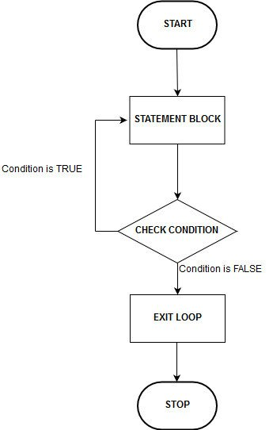
Flowchart
The below flowchart will help you understand the functioning of the do-while loop.

Slide 85
Program to print alphabetical character from a-z
#include <stdio.h>
void main()
{
char ch='a';
do
{
printf("\nThe alphabetic Character %c",ch);
ch++;
} while(ch<='z');
}

Slide 86
program to print ASCII values of all characters
ASCII 0-255
#include<stdio.h>
main()
{
char i=1;
do
{
printf("\nThe ASCII value %c=%d",i,i);
i++;
}
while(i<=100);
}

Slide 87
Program to display even numbers upto 10.
#include <stdio.h>
void main()
{
int i=2;
printf("Find out even from 1-10");
do
{
if(i%2==0)
printf("\nThe given no is even=%d",i);
i++;
}while(i<=10);
}

Slide 88
For loop
When you need to execute a block of code several number of times then you need to use looping concept in C language.
In C Programming Language for loop is a statement which allows code to be repeatedly executed.
It contains 3 parts.
for loop in C language is used to iterate the statements or a part of the program several times.
Initialization
Condition
Increment or Decrements

Slide 89
Initialization:
This step is execute first and this is execute only once when we are entering into the loop first time. This step is allow to declare and initialize any loop control variables.
Condition:
This is next step after initialization step, if it is true, the body of the loop is executed, if it is false then the body of the loop does not execute and flow of control goes outside of the for loop.
Increment or Decrements:
After completion of Initialization and Condition steps loop body code is executed and then Increment or Decrements steps is execute. This statement allows to update any loop control variables.

Slide 90
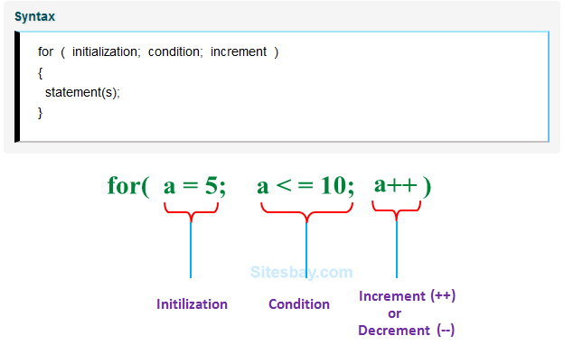
Syntax

Slide 91
Flowchart

Slide 92
Program to sum of numbers
#include <stdio.h>
void main()
{
int i,sum=0,n;
printf("Enter the size of number");
scanf("%d",&n);
for(i=0;i<=n;i++)
{
sum=sum+i;
printf("\nThe sum of given no is=%d",sum);
}
}

Slide 93
C program to find factorial of a number
Factorial of a number ‘n ‘is product of all positive integers less than or equal to n.
It is denoted as n!.
For example
factorial of 5 = 1 * 2 * 3 * 4 * 5 = 120
6= 1 * 2 * 3 * 4 * 5 *6=

Slide 94
C program to find factorial of a number
#include <stdio.h>
void main()
{
int i,fact=1,n;
printf("Enter the value of number");
scanf("%d",&n);
for(i=1;i<=n;i++)
{
fact=fact*i;
}
printf("\nThe Factorial of number%d::%d",n,fact);
}

Slide 95
program to print ASCII values of all characters
#include <stdio.h>
void main()
{
int i;
printf("The ASCII Value");
for(i=0;i<=255;i++)
{
printf("\nThe ascii value of %c::%d",i,i);
}
}

Slide 96
break, continue and goto in C
In c, there are control statements that do not need any condition to control the program execution flow. These control statements are called as unconditional control statements. C programming language provides the following unconditional control statements...
break
continue
goto
The above three statements do not need any condition to control the program execution flow.

Slide 97
break
In C, the break statement is used to perform the following two things...
break statement is used to terminate the switch case statement
break statement is also used to terminate looping statements like while, do-while and for.
When a break statement is encountered inside the switch case statement, the execution control moves out of the switch statement
The break statement terminates the loop body immediately and passes control to the next statement after the loop. In case of inner loops, it terminates the control of inner loop only.

Slide 98
Use break statement
Break statement are mainly used with loop and switch statement. often use the break statement with the if statement.
with loop statement
with switch case
with if statement

Slide 99
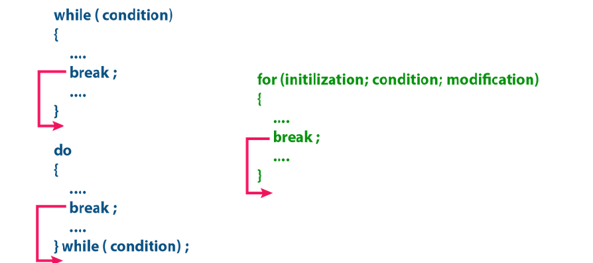

Slide 100
Program to break the loop after 5th natural number print
#include<stdio.h>
#include<conio.h>
void main()
{
int i;
for(i=0;i<=10;i++)
{
if(i==5)
break;
printf("\nThe natural no are=%d",i);
}
}

Slide 101
Program to break the loop after the 6th even no print.
#include<stdio.h>
#include<conio.h>
void main()
{
int i;
for(i=0;i<=10;i++)
{
if(i%2==0)
printf("\nThe EVEN no are=%d",i);
if(i==6)
break;
}
}

Slide 102
Program to print Vowel n Consonant using switch
#include <stdio.h>
main()
{
char ch;
printf("Enter any alphabet: ");
scanf("%c", &ch);
switch(ch)
{
case 'a':
printf("Vowel");
break;
case 'e':
printf("Vowel");
break;
case 'i':
printf("Vowel");
break;
case 'o':
printf("Vowel");
break;
case 'u':
printf("Vowel");
break;

Slide 103
case 'A':
printf("Vowel");
break;
case 'E':
printf("Vowel");
break;
case 'I':
printf("Vowel");
break;
case 'O':
printf("Vowel");
break;
case 'U':
printf("Vowel");
break;
default:
printf("Consonant");
}
}

Slide 104
continue statement
The continue statement is used to move the program execution control to the beginning of the looping statement.
When the continue statement is encountered in a looping statement, the execution control skips the rest of the statements in the looping block and directly jumps to the beginning of the loop.
The continue statement can be used with looping statements like while, do-while and for.
When we use continue statement with while and do-while statements the execution control directly jumps to the condition.
When we use continue statement with for statement the execution control directly jumps to the modification portion (increment/decrement/any modification) of the for loop.
The continue statement execution is as shown in the following figure.

Slide 105
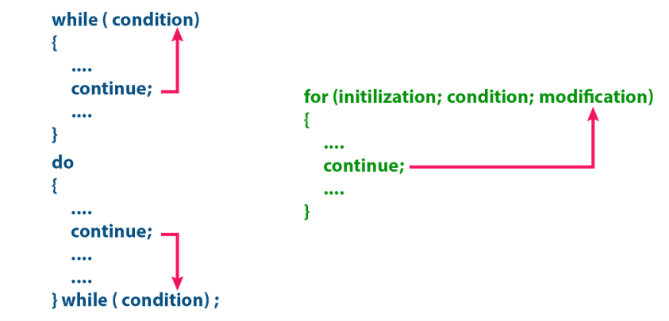

Slide 106
#include <stdio.h>
int main()
{ int i;
for(i=0;i<5;i++)
{
printf("\nHello");
if(i==2)
continue;
printf("\nAgain i am continuing");
}
}

Slide 107
Example Program Program to illustrate continue statement.
#include <stdio.h>
main()
{
int i;
for(i=0;i<20;i++)
{
if(i%2==0)
printf("\nThe even no=%d",i);
Else
continue;
}
}

Slide 108
goto statement
The goto therestatement is used to jump from one line to another line in the program.
Using goto statement we can jump from top to bottom or bottom to top.
To jump from one line to another line, the goto statement requires a label.
Label is a name given to the instruction or line in the program.
When we use a goto statement in the program, the execution control directly jumps to the line with the specified label.

Slide 109
Example Program for goto statement.
#include<stdio.h>
#include<conio.h>
void main()
{
printf("Hellow world!!!\n") ;
goto here ;
printf("This is C program!!!\n") ;
printf("This is goto program!!!\n") ;
here:
printf("INDIA is best country in the whole world!!!\n") ;
printf("I am proud to be Indian");
}

Slide 110
Example Program for goto statement.
#include<stdio.h>
#include<conio.h>
Void positive
{
}
Void odd()
{
}
void main()
{
int table,n,i;
printf("The table of given no") ;
scanf("%d",&n);
goto lebel ;
printf("This is C program!!!\n") ;
printf("This is goto program!!!\n") ;
lebel:
for(i=0;i<=10;i++)
{ table=n*i;
printf("\nThe table of no=%d",table);
}
}

Slide 111
The break is a keyword so it must be used only in lower case letters.
The break statement can not be used with if statement.
The break statement can be used only in switch case and looping statements.
The break statement can be used with if statement, only if that if statement is written inside the switch case or looping statements.
The continue is a keyword so it must be used only in lower case letters.
The continue statement is used only within looping statements.
The continue statement can be used with if statement, only if that if statement is written inside the looping statements.
The goto is a keyword so it must be used only in lower case letters.
The goto statement must require a label.
The goto statement can be used with any statement like if, switch, while, do-while, and for, etc.

Slide 112
Functions
Self containing block of one or more statements or sub-programs which is designed for a particular task is called as Function.
Every c program has at least one function. i.e main()
When we write a program to solve a larger problem, we divide that larger problem into smaller sub problems and are solved individually to make the program easier.
In C, this concept is implemented using functions. Functions are used to divide a larger program into smaller subprograms such that the program becomes easy to understand and easy to implement.
The function contains the set of programming statements enclosed by {}.
A function can be called multiple times to provide reusability and modularity to the C program.
In other words, we can say that the collection of functions creates a program.
The function is also known as procedure or subroutine in other programming languages.

Slide 113
Why use function ?
Function are used for divide a large code into module, due to this we can easily debug and maintain the code.
For example if we write a calculator programs at that time we can write every logic in a separate function (For addition sum(), for subtraction sub()). Any function can be called many times.

Slide 114
Function Aspects
There are three aspects of a C function.
Function declaration A function must be declared globally in a c program to tell the compiler about the function name, function parameters, and return type.
Function call Function can be called from anywhere in the program. The parameter list must not differ in function calling and function declaration. We must pass the same number of functions as it is declared in the function declaration.
Function definition It contains the actual statements which are to be executed. It is the most important aspect to which the control comes when the function is called. Here, we must notice that only one value can be returned from the function.

Slide 115
Function Aspects
There are three aspects of a C function.
Function Declaration
Function Declaration
The function declaration tells the compiler about function name, the data type of the return value and parameters.
The function declaration is also called a function prototype.
The function declaration is performed before the main function or inside the main function or any other function.
Function declaration syntax –
returnType functionName(parametersList/argument list);
E.g void add(int,int);
In the above syntax, returnType specifies the data type of the value which is sent as a return value from the function definition.
The functionName is a user-defined name used to identify the function uniquely in the program.
The parametersList is the data values that are sent to the function definition.

Slide 116
Function Aspects
Function Definition
The function definition provides the actual code of that function.
The function definition is also known as the body of the function. The actual task of the function is implemented in the function definition.
That means the actual instructions to be performed by a function are written in function definition.
The actual instructions of a function are written inside the braces "{ }".
The function definition is performed before the main function or after the main function.
Function definition syntax –
returnType functionName(parametersList) { Actual code... }

Slide 117
Function Aspects
Function Call
The function call tells the compiler when to execute the function definition.
When a function call is executed, the execution control jumps to the function definition where the actual code gets executed and returns to the same functions call once the execution completes.
The function call is performed inside the main function or any other function or inside the function itself.
Function call syntax –
functionName(parameters);

Slide 118
Types of Functions in C
Types of Functions in C
In C Programming Language, based on providing the function definition, functions are divided into two types. Those are as follows...
System Defined Functions
User Defined Functions

Slide 119
System Defined Functions
System Defined Functions
The C Programming Language provides pre-defined functions to make programming easy.
These pre-defined functions are known as system defined functions. The system defined function is defined as follows...
The function whose definition is defined by the system is called as system defined function.
The system defined functions are also called as Library Functions or Standard Functions or Pre-Defined Functions. The implementation of system defined functions is already defined by the system.
In C, all the system defined functions are defined inside the header files like stdio.h, conio.h, math.h, string.h etc., For example, the funtions printf() and scanf() are defined in the header file called stdio.h.

Slide 120
System Defined Functions
Whenever we use system defined functions in the program, we must include the respective header file using #include statement.
For example, if we use a system defined function sqrt() in the program, we must include the header file called math.h because the function sqrt() is defined in math.h.
Points to be Remembered
System defined functions are declared in header files
System defined functions are implemented in .dll files. (DLL stands for Dynamic Link Library).
To use system defined functions the respective header file must be included.

Slide 121
User Defined Functions
User Defined Functions
In C programming language, users can also create their own functions.
The functions that are created by users are called as user defined functions. The user defined function is defined as follows...
The function whose definition is defined by the user is called as user defined function.
That means the function that is implemented by user is called as user defined function. For example, the function main is implemented by user so it is called as user defined function.
In C every user defined function must be declared and implemented. Whenever we make function call the function definition gets executed.
For example, consider the following program in which we create a function called addition with two paramenters and a return value.

Slide 122
User Defined Functions
That means the function that is implemented by user is called as user defined function. For example, the function main is implemented by user so it is called as user defined function.
In C every user defined function must be declared and implemented. Whenever we make function call the function definition gets executed.
For example, consider the program in which we create a function called addition with two paramenters and a return value.
E.g int addition(int,int)

Slide 123
Advantage of functions in C
There are the following advantages of C functions.
By using functions, we can avoid rewriting same logic/code again and again in a program.
We can call C functions any number of times in a program and from any place in a program.
We can track a large C program easily when it is divided into multiple functions.
Reusability is the main achievement of C functions.
Using functions larger programs can be divided into smaller module.
Using functions the program implementation becomes easy.

Slide 124
Demonstration of Function
#include<stdio.h>
void hello();//function declaration
void main()
{
printf("Good morning");
message(); //function call& calling function
printf("\n I live in Tndia");
hello(); //function call& calling function
}
void message() //Function defination&& called function
{
printf("\n I am proud to be Indian");
}
void hello()
{
void message ();//function declaration
printf("\n This is function name");
}

Slide 125
In the concept of functions, the function call is known as
"Calling Function" and the function definition is known as
"Called Function".
When we make a function call, the execution control jumps from calling function to called function.
After executing the called function, the execution control comes back to calling function from called function.
When the control jumps from calling function to called function
,if it may carry one or more data values called "Paramenters" and while
coming back it may carry a single value called "return value".
That means the data values transferred from calling function to called
function are called as Parameters and the data value transferred from
called function to calling function is called Return value.

Slide 126
Based on the data flow between the calling function and called function, the functions are classified as follows...
Function without Parameters and without Return value
Function with Parameters and without Return value
Function without Parameters and with Return value
Function with Parameters and with Return value

Slide 127
Function without Parameters and without Return value
In this type of functions there is no data transfer between calling function and called function.
Simply the execution control jumps from calling-function to called function and executes called function, and finally comes back to the calling function.
For example, consider the following program...

Slide 128
Demonstration of Function
#include <stdio.h>
void hi();// function declaration
main()
{
clrscr();
printf("\nHello World");
hi(); //function call
getch();
}
void hi()//Function defination
{
printf("\nI am the learning function");
printf("\nThis is my first program of function");
}

Slide 129
Example Program
#include<stdio.h>
#include<conio.h>
void addition() ; // function declaration
void main()
{
clrscr() ;
int a,b;
addition() ; // function call fun calling
getch() ;
}
void addition() // function definition .function called
{
int num1, num2 ;
printf("Enter any two integer numbers : ") ;
scanf("%d%d", &num1, &num2);
printf("Sum = %d", num1+num2 ) ;
}

Slide 130
Function with Parameters and without Return value
In this type of functions there is data transfer from calling-function to called function (parameters) but there is no data transfer from called function to calling-function (return value).
The execution control jumps from calling-function to called function along with the parameters and executes called function, and finally comes back to the calling function.
For example, consider the following program...

Slide 131
#include <stdio.h>
void fun(int);
main()
{
int x=5;
clrscr();
printf("The Demonstration program for passing parameter/argument to function");
fun(x);
getch();
}
void fun(int x)
{
printf("\nThe value of x is=%d",x);
}

Slide 132
#include <stdio.h>
void fun(int,int);
main()
{
int x=5,y=10;
printf("The Demonstration program for passing parameter/argument to function");
fun(x,y);
}
void fun(int a,int b)
{
int c;
c=a+b;
printf("\nThe value of x is=%d",c);
}

Slide 133
program to calculate the average of five numbers.
#include<stdio.h>
void average(int, int, int, int, int); //function declaration
void main()
{
int a,b,c,d,e;
printf("\nGoing to calculate the average of five numbers:");
printf("\nEnter five numbers:");
scanf("%d %d %d %d %d",&a,&b,&c,&d,&e);
average(a,b,c,d,e); // function call
}
void average(int a, int b, int c, int d, int e) // function definition
{
float avg;
avg = (a+b+c+d+e)/5;
printf("The average of given five numbers : %f",avg);
}

Slide 134
What is Fibonacci series?
Fibonacci series is a series of numbers where the current number is the sum of previous two terms. For Example: 0, 1, 1, 2, 3, 5, 8, 13, 21, ... , (n-1th + n-2th)
#include<stdio.h>
void fibb(int);
void main()
{
int n,fib;
printf("Enter the numbers");
scanf("%d",&n);
fibb(n);
}
void fibb(int s)
{
int a,b,c,i,n;
a=0;
b=1;
c=0;
for(i=0;i<s;i++)
{
printf("%d,",c);
a=b;
b=c;
c=a+b;
}
}

Slide 135
int a,b,c,i,n;
a=0;
b=1;
c=0;
for(i=0;i<4;i++)
{
printf("%d,",c);
a=b;
b=c;
c=a+b; }
o/p 0,1,1,2
O=> a=1,b=0,c=1+0=1
1 => a=0,b=1,c=1
2 =>a=1,b=1,c=2
3=> a=1, b=2,c=3
4

Slide 136
#include<stdio.h>
#include<conio.h>
void main(){
int num1, num2 ;
void addition(int, int) ; // function declaration
clrscr() ;
printf("Enter any two integer numbers : ") ;
scanf("%d%d", &num1, &num2);
addition(num1, num2) ; // function call
getch() ;
}
void addition(int a, int b) // function definition
{
printf("Sum = %d", a+b ) ;
}

Slide 137
Function without Parameters and with Return value
In this type of functions there is no data transfer from calling-function to called-function (parameters) but there is data transfer from called function to calling-function (return value).
The execution control jumps from calling-function to called function and executes called function, and finally comes back to the calling function along with a return value.
For example, consider the following program...

Slide 138
Find Cube of A no
#include <stdio.h>
int cube();/fun declaration
main()
{
int result;
printf("Hello World");
result=cube(); //fun calling
printf("\nThe cube of no is=%d",result);
}
Int cube()// fun definatiom
{
int cube,n;
printf("\nEnter The no");
scanf("%d",&n);
cube=n*n*n;
return cube;
}

Slide 139
program to calculate the area of the square
#include<stdio.h>
int sum(); // function declaration
void main()
{
printf("Going to calculate the area of the square\n");
float area = square(); // function call
printf("The area of the square: %f\n",area);
}
int square() // function definition
{
float side;
printf("Enter the length of the side in meters: ");
scanf("%f",&side);
return side * side;
}

Slide 140
Area of Circle
#include<stdio.h>
int circle(); // function declaration
void main()
{
float area;
printf("Going to calculate the area of the circle\n");
area = circle(); // function call
printf("The area of the circle: %f\n",area);
}
int circle() // function definition
{
int r,res;
printf("Enter the radius of the circle: ");
scanf("%d",&r);
res=3.14*r*r;
return res;
}

Slide 141
Addition of a no
#include<stdio.h>
#include<conio.h>
void main()
{
int result ;
int addition() ; // function declaration
clrscr() ;
result = addition() ; // function call
printf("Sum = %d", result) ;
getch() ;
}
int addition() // function definition
{
int num1, num2 ;
printf("Enter any two integer numbers : ") ;
scanf("%d%d", &num1, &num2);
return (num1+num2) ;
}

Slide 142
Function with Parameters and with Return value
Function with Parameters and with Return value
In this type of functions there is data transfer from calling-function to called-function (parameters) and also from called function to calling-function (return value).
The execution control jumps from calling-function to called function along with parameters and executes called function, and finally comes back to the calling function along with a return value.
For example, consider the following program...

Slide 143
Square root of a function
#include <stdio.h>
#include<math.h>
int squrt(int);
main()
{
int n,result;
printf("Enter a no");
scanf("%d",&n);
result=squrt(n);
printf("The squre root ofa no is=%d",squ);
}
int squrt(int a)
{
int sol;
sol=sqrt(a);
return sol;
}

Slide 144
Program to check whether a number is even or odd
#include<stdio.h>
int even_odd(int);
void main()
{
int n,flag=0;
printf("\nGoing to check whether a number is even or odd");
printf("\nEnter the number: ");
scanf("%d",&n);
flag = even_odd(n);
if(flag == 1)
{
printf("\nThe number is even");
}
else
{
printf("\nThe number is odd");
}
}
int even_odd(int n)
{
if(n%2 == 0)
{
return 1;
}
else
{
return 0;
}
}

Slide 145
Factorial of a number n
Factorial of a number n is product of all positive integers less than or equal to n. It is denoted as n!.
For example factorial of 5 = 1 * 2 * 3 * 4 * 5 = 120
#include <stdio.h>
int fact(int);
main()
{ int n,res;
printf("Enter a no");
scanf("%d",&n);
res=fact(n);
printf("The factorial of a given no is=%d",res);
}
int fact(int a)
{
int i,fact=1;
for(i=1;i<=a;i++)
{
fact=fact*i;
}
return fact;
}

Slide 146
To check whether given no is Prime or Not
Prime number in C: Prime number is a number that is greater than 1 and divided by 1 or itself. In other words, prime numbers can't be divided by other numbers than itself or 1. For example 2, 3, 5, 7, 11, 13, 17, 19, 23.... are the prime numbers.

Slide 147
#include<stdio.h>
int prime(int);
void main()
{
int n,res;
printf("\nGoing to check whether a number is Prime");
printf("\nEnter the number: ");
scanf("%d",&n);
res = prime(n);
if(res == 0)
printf("\nThe number is Prime");
else
printf("\nThe number is not Prime");
}
int prime(int n)
{
if(n%2 == 0)
return 1;
else
return 0;
}

Slide 148
Example Program
#include<stdio.h>
#include<conio.h>
void main(){
int num1, num2, result ;
int addition(int, int) ; // function declaration
clrscr() ;
printf("Enter any two integer numbers : ") ;
scanf("%d%d", &num1, &num2);
result = addition(num1, num2) ; // function call
printf("Sum = %d", result) ;
getch() ;
}
int addition(int a, int b) // function definition
{
return (a+b) ;
}

Slide 149
call by value
In call by value method, the value of the actual parameters is copied into the formal parameters.
In other words, we can say that the value of the variable is used in the function call in the call by value method.
In call by value method, we can not modify the value of the actual parameter by the formal parameter.
In call by value, different memory is allocated for actual and formal parameters since the value of the actual parameter is copied into the formal parameter.
The actual parameter is the argument which is used in the function call whereas formal parameter is the argument which is used in the function definition.

Slide 150
#include<stdio.h>
void change (int);
void change(int num)
{
printf("Before adding value inside function num=%d \n",num);
num=num+100;
printf("After adding value inside function num=%d \n", num);
}
int main()
{
int x=100;
printf("Before function call x=%d \n", x);
change(x);//passing value in function
printf("After function call x=%d \n", x);
}

Slide 151
#include <stdio.h>
void swap(int , int); //prototype of the function
int main()
{
int a = 10;
int b = 20;
printf("Before swapping the values in main a = %d, b = %d\n",a,b); // printing the value of a and b in main
swap(a,b);
printf("After swapping values in main a = %d, b = %d\n",a,b); // The value of actual parameters do not change
by changing the formal parameters in call by value, a = 10, b = 20
}
void swap (int a, int b)
{
int temp;
temp = a;
a=b;
b=temp;
printf("After swapping values in function a = %d, b = %d\n",a,b); // Formal parameters, a = 20, b = 10
}

Slide 152
Call by Reference
In call by reference, the address of the variable is passed into the function call as the actual parameter.
The value of the actual parameters can be modified by changing the formal parameters since the address of the actual parameters is passed.
In call by reference, the memory allocation is similar for both formal parameters and actual parameters.
All the operations in the function are performed on the value stored at the address of the actual parameters, and the modified value gets stored at the same address.

Slide 153
pointer
The pointer in C language is a variable which stores the address of another variable.
This variable can be of type int, char, array, function, or any other pointer.
main()
{
int n = 10;
int* p = &n;
printf("\nThe value of P=%d",p);
printf("\nThe value of N=%d",n);
}

Slide 154
#include<stdio.h>
void change(int *);
int main() {
int x=100;
printf("Before function call x=%d \n", x);
change(&x);//passing reference in function
printf("After function call x=%d \n", x);
return 0;
}
void change(int *num) {
printf("Before adding value inside function num=%d \n",*num);
*num=*num+100;
printf("After adding value inside function num=%d \n", *num);
}

Slide 155
#include <stdio.h>
void swap(int *, int *); //prototype of the function
int main()
{
int a = 10;
int b = 20;
printf("Before swapping the values in main a = %d, b = %d\n",a,b); // printing the value of a and b in main
swap(&a,&b);
printf("After swapping values in main a = %d, b = %d\n",a,b); // The values of actual parameters do change in call by reference, a = 10, b = 20
}
void swap (int *a, int *b)
{
int temp;
temp = *a;
*a=*b;
*b=temp;
printf("After swapping values in function a = %d, b = %d\n",*a,*b); // Formal parameters, a = 20, b = 10
}

Slide 156
#include<stdio.h>
#include<conio.h>
void main()
{
auto int num1, num2 ;
void swap(int *,int *) ; // function declaration
clrscr() ;
num1 = 10 ;
num2 = 20 ;
printf("\nBefore swap: num1 = %d, num2 = %d", num1, num2) ;
swap(&num1, &num2) ; // calling function
printf("\nAfter swap: num1 = %d, num2 = %d", num1, num2);
getch() ;
}
void swap(int *a, int *b) // called function
{
int temp ;
temp = *a ;
*a = *b ;
*b = temp ;
}

Slide 157
Difference between call by value and call by reference in c
No. | Call by value | Call by reference
1 | A copy of the value is passed into the function | An address of value is passed into the function
2 | Changes made inside the function is limited to the function only. The values of the actual parameters do not change by changing the formal parameters. | Changes made inside the function validate outside of the function also. The values of the actual parameters do change by changing the formal parameters.
3 | Actual and formal arguments are created at the different memory location | Actual and formal arguments are created at the same memory location

Slide 158
Storage Classes in C
Storage classes in C are used to determine the lifetime, visibility, memory location, and initial value of a variable. There are four types of storage classes in C
Automatic
External
Static
Register

Slide 159
Storage Classes in C: auto, extern, static, register class in C
What is Storage Class in C?
A storage class represents the visibility and a location of a variable. It tells from what part of code we can access a variable.
storage Classes are used to describe the features of a variable/function.
These features basically include the store scope and life-time which help us to trace the existence of a particular variable during the runtime of a program.
A storage class in C is used to describe the following things:
The variable scope.
The location where the variable will be stored.
The initialized value of a variable.
A lifetime of a variable.

Slide 160
Who can access a variable?
Thus a storage class is used to represent the information about a variable.
NOTE: A variable is not only associated with a data type, its value but also a storage class.
There are total four types of standard storage classes. The table below represents the storage classes in C.
Storage class | Purpose
auto | It is a default storage class.
extern | It is a global variable.
static | It is a local variable which is capable of returning a value even when control is transferred to the function call.
register | It is a variable which is stored inside a Register.

Slide 161
Storage Classes | Storage Place | Default Value | Scope | Lifetime
auto | RAM | Garbage Value | Local | Within function
extern | RAM | Zero | Global | Till the end of the main program Maybe declared anywhere in the program
static | RAM | Zero | Local | Till the end of the main program, Retains value between multiple functions call
register | Register | Garbage Value | Local | Within the function

Slide 162
Automatic variables: auto
Scope:
Variable defined with auto storage class are local to the function block inside which they are defined.
Default Initial Value:
Any random value i.e garbage value.
Lifetime:
Till the end of the function/method block where the variable is defined.
A variable declared inside a function without any storage class specification, is by default an automatic variable. They are created when a function is called and are destroyed automatically when the function's execution is completed. Automatic variables can also be called local variables because they are local to a function. By default they are assigned garbage value by the compiler.

Slide 163
#include<stdio.h>
void main()
{
auto int a=5;
printf("\n%d",a);
}

Slide 164
void main()
{
auto int a=8;
{
auto int b=5;
printf("\n%d",b);
printf("\n%d",a);
}
//printf("\n%d",b);
printf("\n%d",a);
}

Slide 165
#include<stdio.h>
void test();
int main()
{
test();
test();
test();
}
void test()
{
auto int a = 0;
a = a + 1;
printf("%d\t",a);
}
o/p 1 1 1

Slide 166
Static variables
Scope: Local to the block in which the variable is defined
Default initial value: 0(Zero).
Lifetime: Till the whole program doesn't finish its execution.
A static variable tells the compiler to persist/save the variable until the end of program. Instead of creating and destroying a variable every time when it comes into and goes out of scope, static variable is initialized only once and remains into existence till the end of the program. A static variable can either be internal or external depending upon the place of declaration. Scope of internal static variable remains inside the function in which it is defined. External static variables remain restricted to scope of file in which they are declared.
They are assigned 0 (zero) as default value by the compiler.

Slide 167
#include<stdio.h>
void main()
{
static int a;
printf("\n%d",a);
}

Slide 168
#include<stdio.h>
void test(); //Function declaration (discussed in next topic)
int main()
{
test();
test();
test();
}
void test()
{
static int a = 0; //a static variable
a = a + 1;
printf("%d\t",a);
}
o/p
1 2 3

Slide 169
External or Global variable(extern)
Scope:
Global i.e everywhere in the program. These variables are not bound by any function, they are available everywhere.
Default initial value: 0(zero).
Lifetime: Till the program doesn't finish its execution, you can access global variables.
A variable that is declared outside any function is a Global Variable. Global variables remain available throughout the program execution. By default, initial value of the Global variable is 0(zero). One important thing to remember about global variable is that their values can be changed by any function in the program.

Slide 170
Here the global variable number is available to all three functions and thus, if one function changes the value of the variable, it gets changed in every function.
Note: Declaring the storage class as global or external for all the variables in a program can waste a lot of memory space because these variables have a lifetime till the end of the program. Thus, variables, which are not needed till the end of the program, will still occupy the memory and thus, memory will be wasted.

Slide 171
#include<stdio.h>
int number; // global variable
void main()
{
number = 10;
printf("I am in main function. My value is %d\n", number);
fun1(); //function calling, discussed in next topic
fun2(); //function calling, discussed in next topic }
/* This is function 1 */
fun1()
{
number = 20;
printf("I am in function fun1. My value is %d", number); }
/* This is function 1 */
fun2()
{
printf("\nI am in function fun2. My value is %d", number);
}
O/p
I am in function main. My value is 10
I am in function fun1. My value is 20
I am in function fun2. My value is 20

Slide 172
#include<stdio.h>
void fun1();
void fun2();
int a ;// global variable
void main()
{
printf("I am in main function.The My value a is %d\n", a);
fun1();
fun2();
printf("\nI am in main function.The My value a is %d\n", a);
}
/* This is function 1 */
void fun1()
{
a=a+2;
printf("I am in function fun1. My value a is %d", a);
}
/* This is function 2 */
void fun2()
{
a=a+10;
printf("\nI am in function fun2. My value a is %d", a);
}

Slide 173
Register variable
Scope: Local to the function in which it is declared.
Default initial value: Any random value i.e garbage value
Lifetime: Till the end of function/method block, in which the variable is defined.
Register variables inform the compiler to store the variable in CPU register instead of memory. Register variables have faster accessibility than a normal variable. Generally, the frequently used variables are kept in registers. But only a few variables can be placed inside registers. One application of register storage class can be in using loops, where the variable gets used a number of times in the program, in a very short span of time.
NOTE: We can never get the address of such variables.

Slide 174
The variables defined as the register is allocated the memory into the CPU registers depending upon the size of the memory remaining in the CPU.
We can not dereference the register variables, i.e., we can not use &operator for the register variable.
The access time of the register variables is faster than the automatic variables.
The initial default value of the register local variables is 0.
The register keyword is used for the variable which should be stored in the CPU register. However, it is compiler?s choice whether or not; the variables can be stored in the register.
We can store pointers into the register, i.e., a register can store the address of a variable.
Static variables can not be stored into the register since we can not use more than one storage specifier for the same variable.

Slide 175
#include<stdio.h>
void main()
{
int a=8;
register int b=5;
printf("\n%d",b);
printf("\n%d",a);
}

Slide 176
Recursive Functions in C
In C programming language, function calls can be made from the main() function, other functions or from the same function itself. The recursive function is defined as follows...
A function called by itself is called recursive function.
The recursive functions should be used very carefully because, when a function called by itself it enters into the infinite loop. And when a function enters into the infinite loop, the function execution never gets completed. We should define the condition to exit from the function call so that the recursive function gets terminated.
When a function is called by itself, the first call remains under execution till the last call gets invoked. Every time when a function call is invoked, the function returns the execution control to the previous function call.

Slide 177
#include<stdio.h>
#include<conio.h>
int factorial( int ) ;
int main()
{
int fact, n ;
printf("Enter any positive integer: ") ;
scanf("%d", &n) ;
fact = factorial( n ) ;
printf("\nFactorial of %d is %d\n", n, fact) ;
return 0;
}
int factorial( int n )
{
int temp ;
if( n == 0)
return 1 ;
else
temp = n * factorial( n-1 ) ; // recursive function call
return temp ;
}

Slide 178
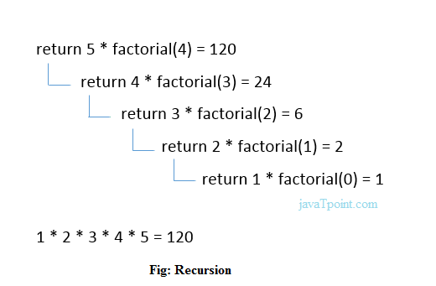

Slide 179
